Slide 1

Malaria Detection
Presented To Professor Shaker El-Sappagh
Date: 5/13/2025

Slide 2
Team Members (team no:27)
Mohamed Elsayed Nagy | 222200002
Ahmed Nabil Hasan | 223103503
Mohamed Adel Gamal | 223105470
Hazem mohamed aboelrous | 223105573
Mahmoud Adel Gamal | 223105471
Youssef Essam Moustafa | 222101958

Slide 3
Abstract
Utilized a dataset of 27,000+ images from the National Institutes of Health (NIH)
Developed a deep learning model based on CNN
Classifies malaria-infected vs. uninfected cells from microscopy images
Achieved high accuracy, enabling scalable and rapid diagnostics

Slide 4
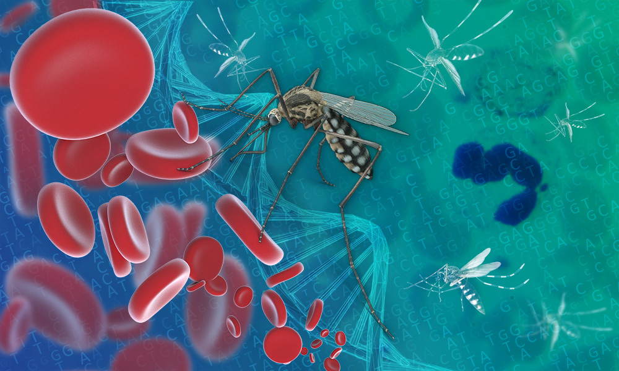
Introduction
Malaria is a serious and potentially fatal parasitic disease
Early detection is critical for effective treatment
Manual diagnosis is often slow, inconsistent, and resource-intensive
Convolutional Neural Networks (CNNs) offer automated, accurate image classification
Project Goal: Build a robust AI model to support medical diagnosis

Slide 5
The Project Problem
Business Challenge: Lack of fast and reliable diagnostics in underserved areas
Technical Challenge: Accurately identifying parasitized cells across varying image conditions
Objective: Build an AI-driven solution to automate diagnosis and minimize human error

Slide 6
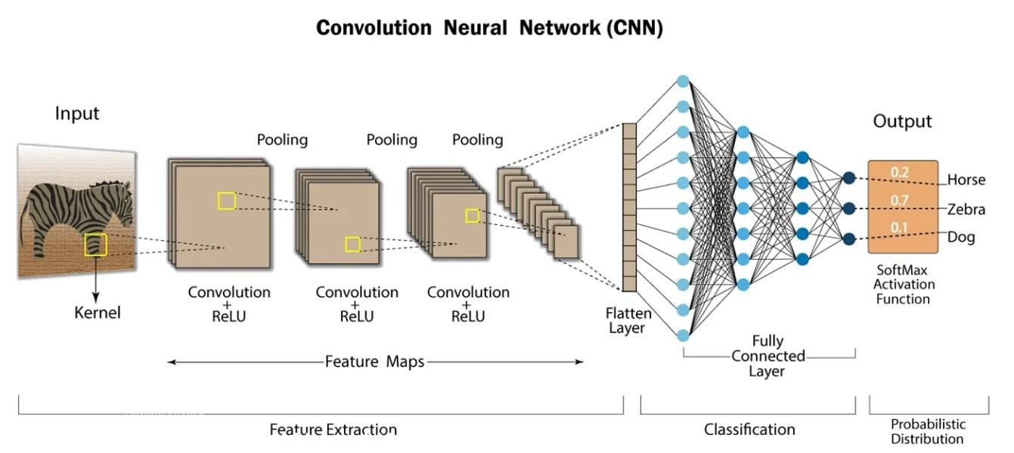
Solved Challenges
Model built using CNN
Preprocessing and balancing applied to improve dataset quality
Used early stopping and other optimization techniques

Slide 7
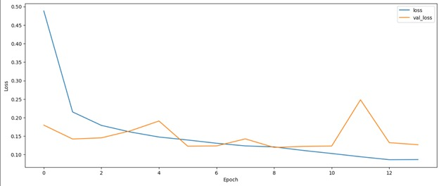
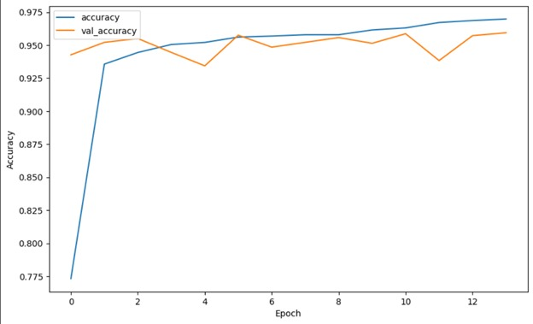
The result of affected and non-affected
Before Augmentation

Slide 8
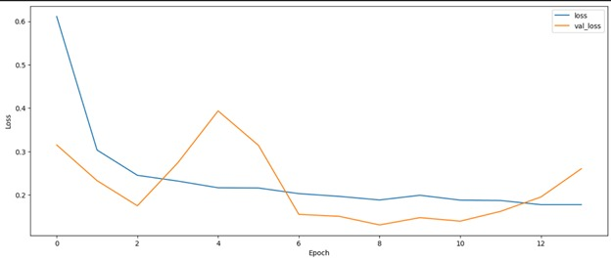
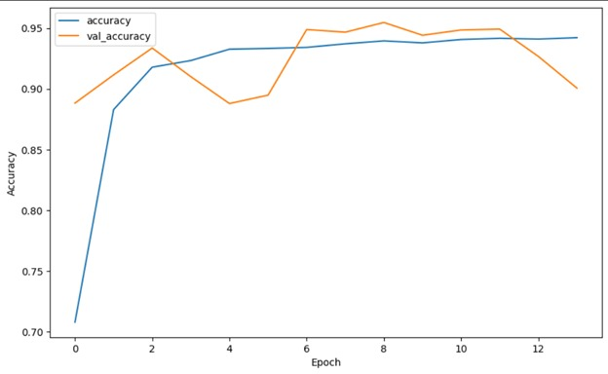
The result of affected and non-affected
After Augmentation

Slide 9
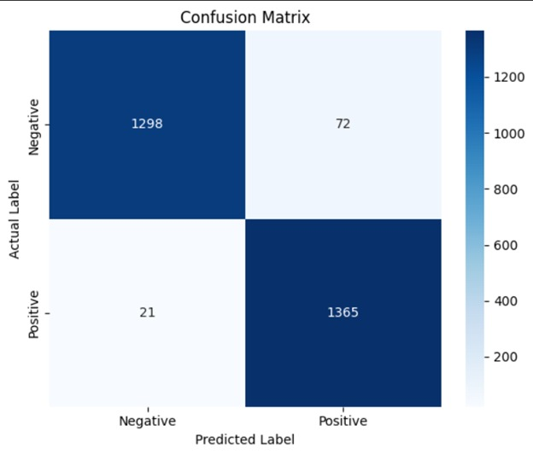
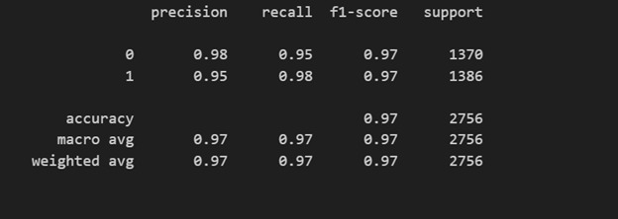
Confusion Matrix

Slide 10
Future Work
Train model with more diverse and augmented datasets
Deploy as a mobile or web app for clinical use in remote settings
Add explainability tools such as Grad-CAM to visualize predictions
Expand system to detect other blood-related diseases
Partner with healthcare institutions for real-world testing

Slide 11
Conclusion
The model demonstrates high diagnostic accuracy and practical value
Deep learning offers cost-effective, scalable diagnostic tools
Reinforces the role of AI in advancing global health
Lays the groundwork for further research and deployment in medical AI

Slide 12
References
Centers for Disease Control and Prevention. (n.d.). About malaria. Retrieved from https://www.cdc.gov/malaria/about/
National Institutes of Health. (n.d.). Malaria datasets. National Library of Medicine. Retrieved from https://ceb.nlm.nih.gov/repositories/malaria-datasets/
Simonyan, K., & Zisserman, A. (2015). Very deep convolutional networks for large-scale image recognition. arXiv preprint arXiv:1409.1556. https://arxiv.org/abs/1409.1556
Abadi, M., Barham, P., Chen, J., Chen, Z., Davis, A., Dean, J., ... & Zheng, X. (2015). TensorFlow: Large-scale machine learning on heterogeneous systems. Retrieved from https://www.tensorflow.org/
Chollet, F., et al. (2015). Keras. Retrieved from https://keras.io/
Pedregosa, F., Varoquaux, G., Gramfort, A., Michel, V., Thirion, B., Grisel, O., ... & Duchesnay, E. (2011). Scikit-learn: Machine learning in Python. Journal of Machine Learning Research, 12, 2825–2830. https://scikit-learn.org/

Slide 13
Thank you

